Slide 1
Digital Communication 23EC2208
Spread-Spectrum Communications
Dr. M. Venu Gopala Rao
A.M.I.E.T.E, M.Tech, Ph.D(Engg)
Cert. in R.S.T ( City & Guild’s London Institute, London)
F.I.E.T.E, L.M.I.S.T.E, I.S.O.I., S.S.I., M.I.A.E.
Professor, Dept. of ECE, K L University
mvgr03@kluniversity.in

Slide 2
Introduction
In traditional digital communication systems, the design of baseband pulse-shaping and modulation techniques aim to minimize the amount of bandwidth consumed by the modulated signal during transmission. This principal objective is clearly motivated by the desire to achieve high spectral efficiency and thus to conserve bandwidth resource.
Nevertheless, a narrowband digital communication system exhibits two major weaknesses.
First, its concentrated spectrum makes it an easy target for detection and interception by unintended users (e.g., battlefield enemies and unauthorized eavesdroppers).
Second, its narrow band, having very little redundancy, is more vulnerable to jamming, since even a partial band jamming can jeopardize the signal reception.
Spread spectrum technologies were initially developed for the military and intelligence communities to overcome the two afore mentioned short comings against interception and jamming.

Slide 3
The basic idea was to expand each user signal to occupy a much broader spectrum than necessary. For fixed transmission power, a broader spectrum means both lower signal power level and higher spectral redundancy.
The low signal power level makes the communication signals difficult to detect and intercept,
whereas high spectral redundancy makes the signals more resilient against partial band jamming and interference, whether intentional or unintentional.
The definition of spread spectrum may be stated in two parts:
1. Spread Spectrum is a means of transmission in which the data sequence occupies a bandwidth in excess of the minimum bandwidth necessary to send it.
2. The spectrum spreading is accomplished before transmission through the use of a (spreading) code that is independent of the data sequence.
The same code is used in the receiver (operating in synchronism with the transmitter) to despread the received signal so that the original data sequence may be recovered.

Slide 4
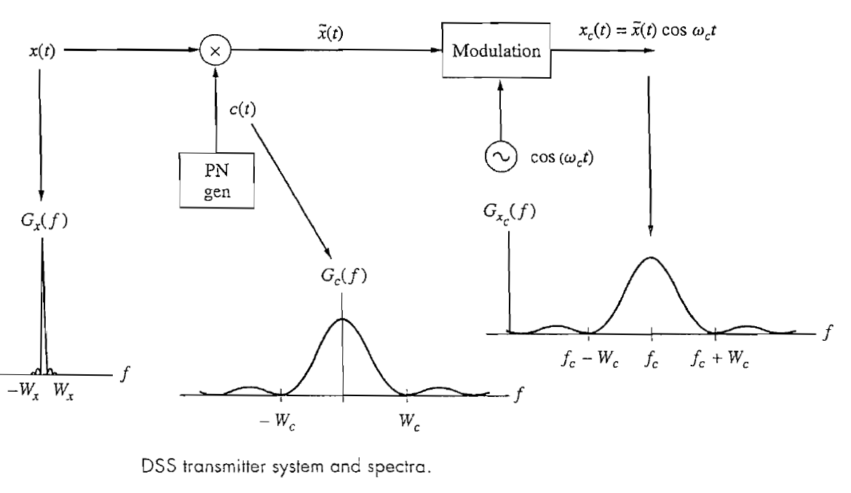

Slide 5
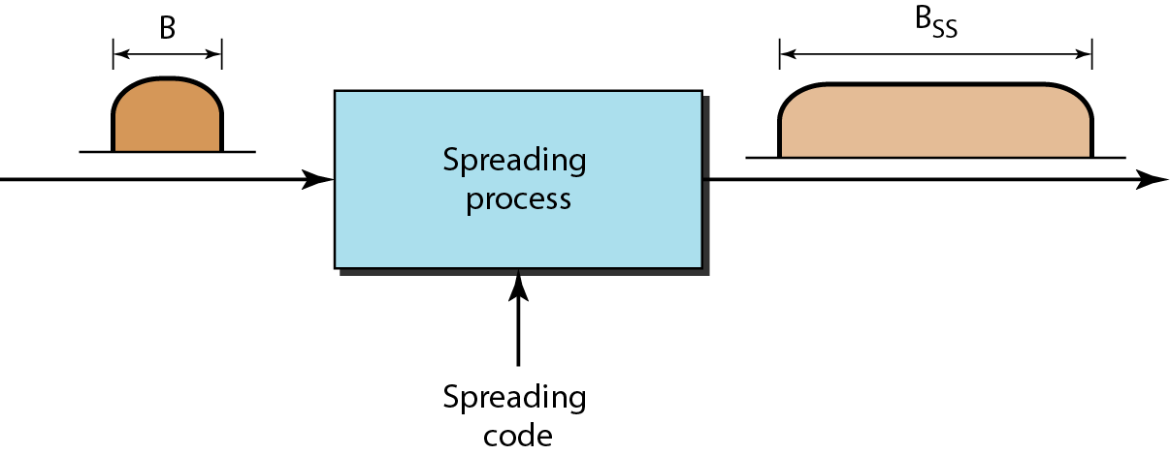
Spreading the input data
Pseudo noise (PN) code symbols are called chips
Chip rate or PN code rate R_{c} >> R_{original signal}

Slide 6
There are many application fields for spreading the spectrum:
Antijamming,
Interference rejection,
Low probability of intercept,
Multiple access, Multipath reception,
mobile communications
Diversity reception,
High resolution ranging,
Accurate universal timing
Advantages of Spread Spectrum:
Increased tolerance to interferences.
Low probability of detection and interception.
Increased tolerance to multipath.
Increased ranging capabilities.

Slide 7
Types of Spread Spectrum
Direct Sequence Spread Spectrum
Frequency Hope Spread Spectrum

Slide 8
Direct Sequence Spread Spectrum

Slide 9

Idealized model of Baseband Spread Spectrum Communication System

Slide 10
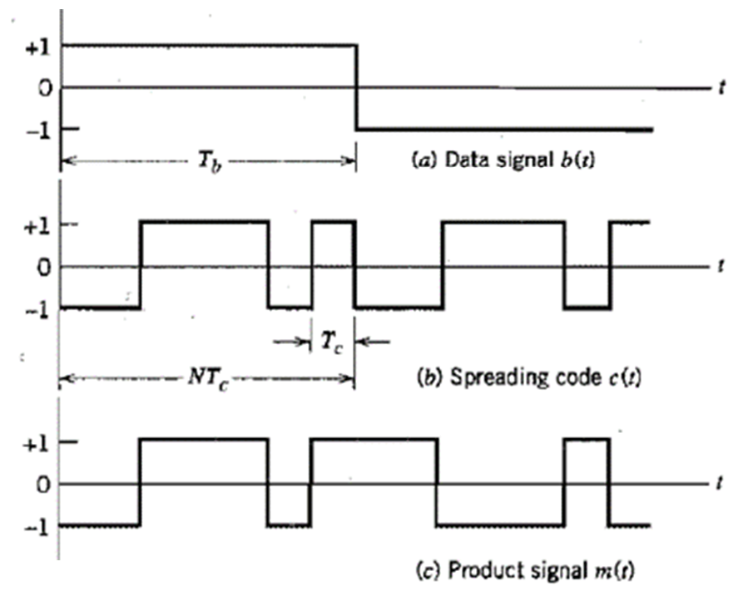

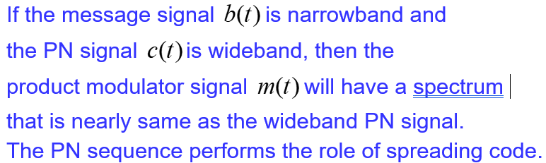

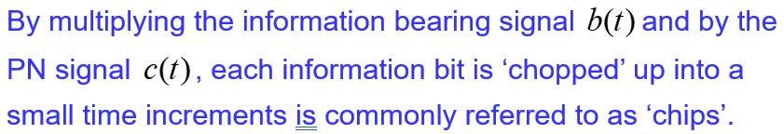
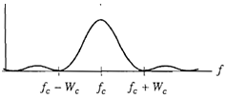

Slide 11
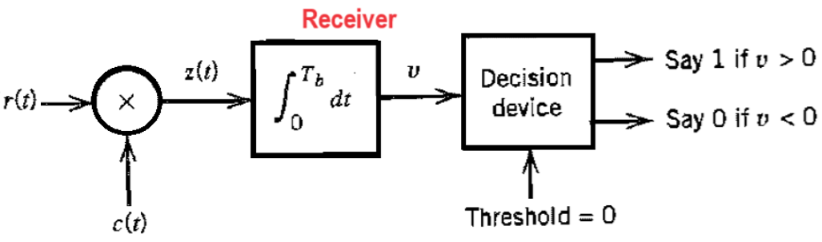
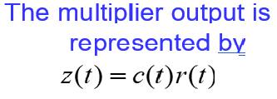


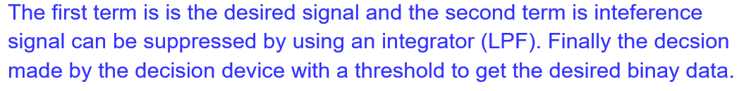

Slide 12
Direct Sequence Spread Spectrum with Coherent BPSK

Slide 13
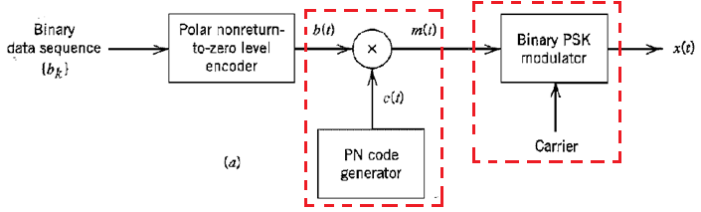


DSSS with Coherent BPSK

Slide 14
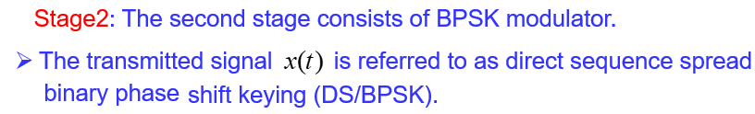
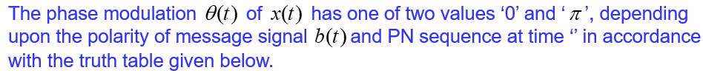
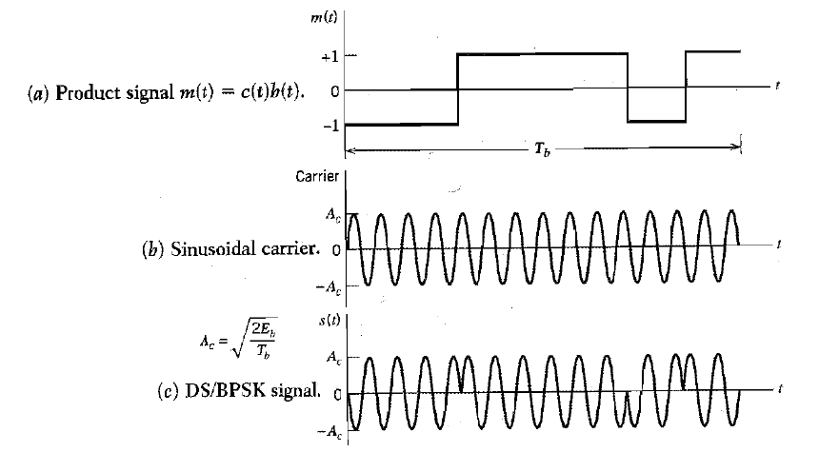

Slide 15
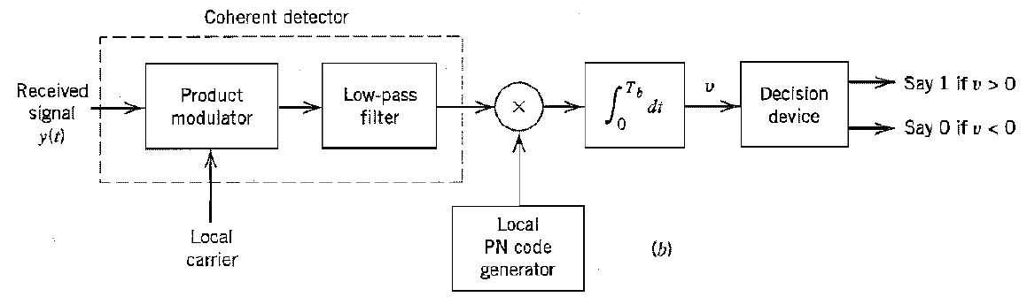

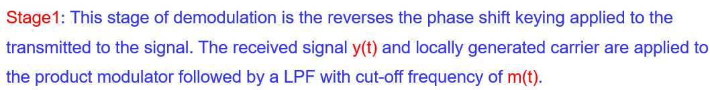
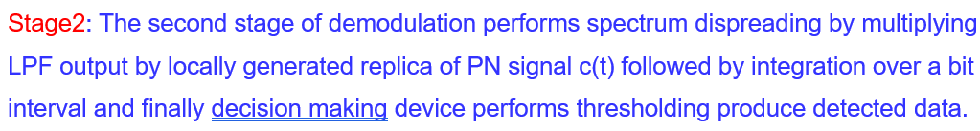
Coherent Demodulation

Slide 16
Model of DSSS BPSK System for Analysis Purpose

Slide 17
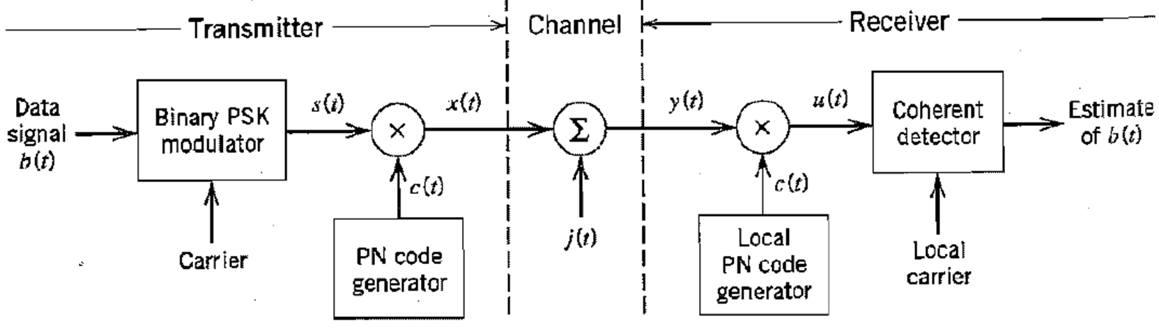

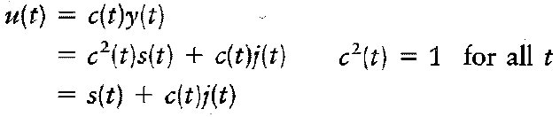
Model of DSSS BPSK System for Analysis Purpose
Interchanging the operations of spectrum spreading and BPSK modulation

Slide 18
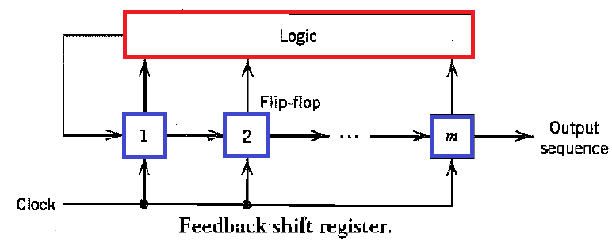
Pseudo Noise (PN) Sequences
Pseudo Noise (PN) Sequence is a periodic binary sequence with noise like waveform that is usually generated by means of a feedback register.
A feedback shift register consists of
1. An ordinary shift register made up of m flip-flops, and
2. A logic circuit that ate interconnected to form multi-loop feedback circuit.
The flip-flops in shift register are regulated by a single timing clock.
At each pulse (tick) of the clock the state of each flip-flop is shifted to the next one down the line.
With each clock pulse the logic circuit computes Boolean function of the states of the flip-flops.
The PN sequence is generated by length m of the shift register, its initial state and feed back logic.

Slide 19
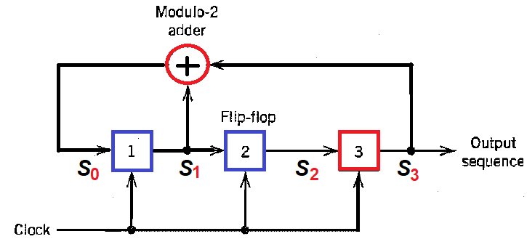
Example: Maximum sequence
generator for m = 3.
Assume initial state: 1 0 0
Then the successive states are:
1 0 0, 1 1 0, 1 1 1, 0 1 1, 0 0 1, 1 0 0
The output sequence (the last
position of each state of the shift register) is therefore 0 0 1 1 1 0 1 0 ….

Slide 20
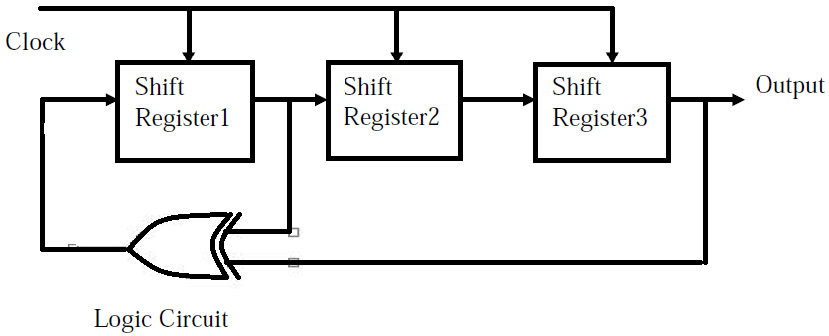
Maximum-length sequence generator for m = 3

Slide 21

Properties of m-sequence
Property1: Balance property: I each period of m-sequence, the No. of ‘1’s is always one more than the No. of ‘o’s.
Property2: Runs property: Among the runs of ‘1’s and ‘0’s, in each period of m-sequence, one half the runs of each kind are of length one, one-fourth are of length two, one-eight are of length three and so on.
Property3: Correlation Property: The Autocorrelation function of m-sequence is periodic and binary valued.
The period of m-sequence length is given by
Let the binary symbols 0 and 1 of the sequence denoted by the levels -1 and +1 respectively.

Slide 22
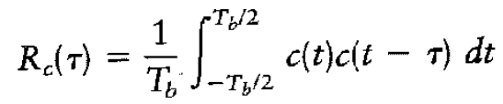
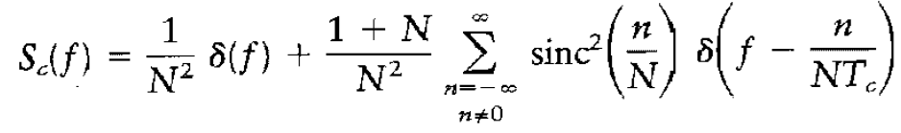
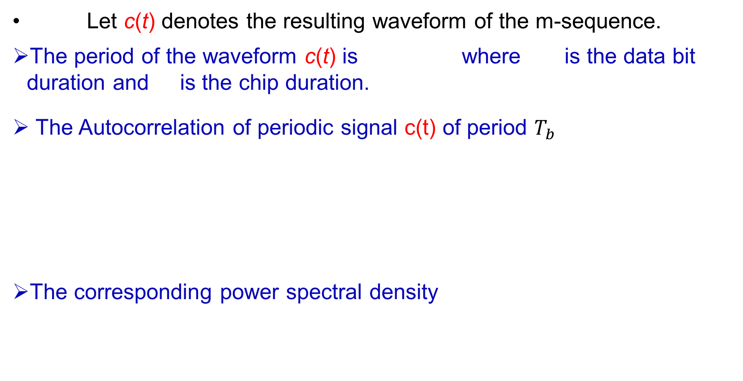

Let c(t) denotes the resulting waveform of the m-sequence.
The period of the waveform c(t) is where is the data bit duration and is the chip duration.
The Autocorrelation of periodic signal c(t) of period $T_{b}$
The corresponding power spectral density
$$T_{b}$$

Slide 23
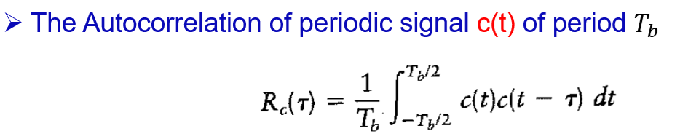
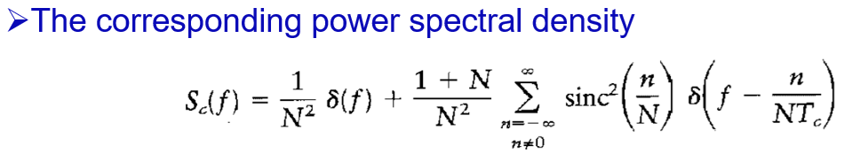

Slide 24
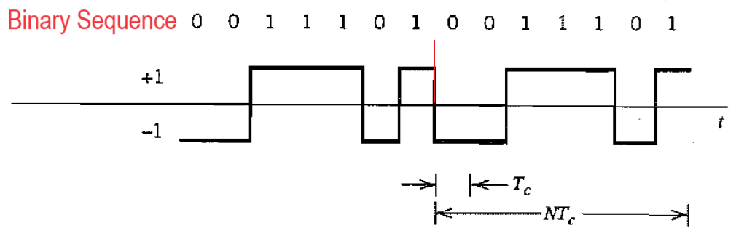

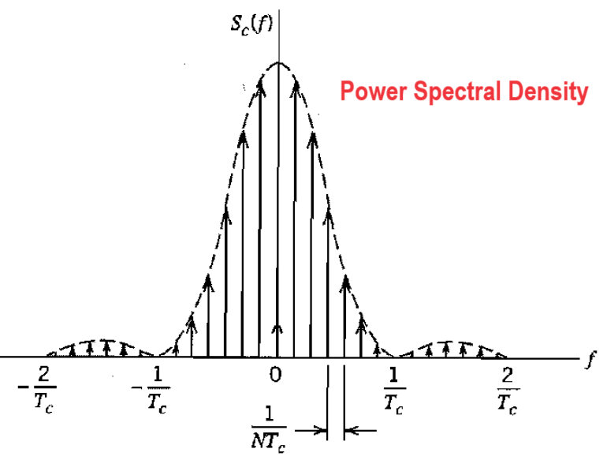
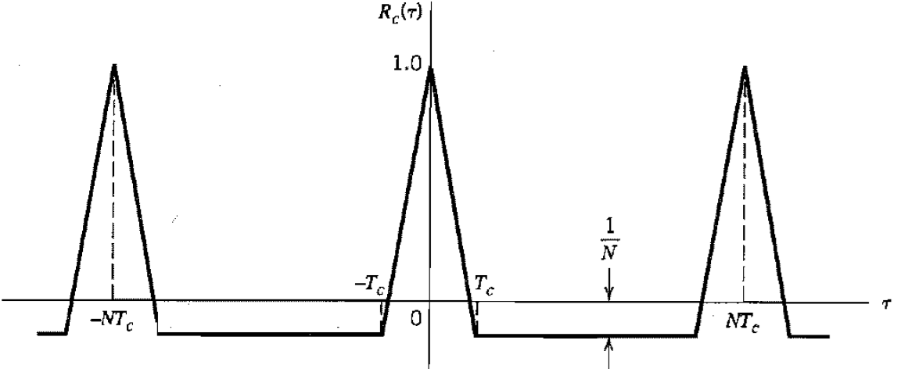

Slide 25
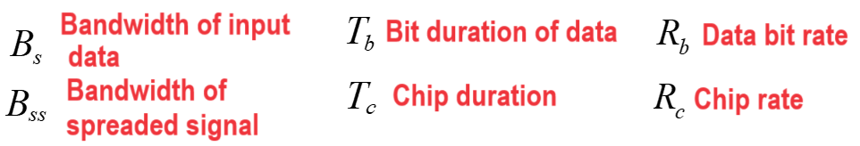
Processing Gain
Processing gain is the ratio of the spread RF bandwidth to the original information bandwidth.
The effect of multipath fading as well as interference can be reduced by a factor equivalent to the processing gain.
In fact, it quantifies the degree of interference rejection.

Slide 26
A direct sequence spread binary phase shift keying system uses a feedback shift register of length 19 for the generation of PN sequence. Calculate the processing gain of the system.
Ans: Given length of shift register = m =19
Therefore, length of PN sequence N = 2^{m} - 1 = 2¹⁹ – 1= 524287
Processing gain PG = Tb/Tc = N in dB =10log₁₀N
= 10 log₁₀ (2¹⁹) = 57 dB

Slide 27
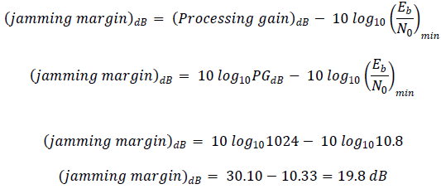
A Spread spectrum communication system has the following parameters. Information bit duration Tb = 1.024 msecs and PN chip duration of 1μsecs. The average probability of error of system is not to exceed 10-5. Calculate (a) Length of shift register (b) Processing gain (c) jamming margin
Ans: Processing gain PG =N= Tb/Tc =1024, then length of shift register m = 10
In case of coherent BPSK For Probability of error 10⁻⁵. [Referring to error function table] Eb/N0 =10.8. Therefore jamming margin

Slide 28
End

